Slide 1

Corporate law and economics (LL4489V/5489V/6489V) 2. the economic approach to corporate law II
LL4489V
Kenneth Khoo
kenneth.khoo@nus.edu.sg

Slide 2

THE FOUNDATIONS OF COMPANY LAW
Recap
Exchange and the Coase Theorem

Slide 3
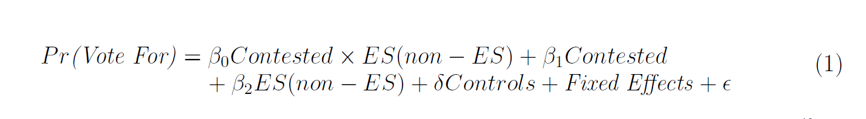
recap
Recall our Discussion last week: Up to this point, our discussion of economic analysis has been purely theoretical.
What about the “fabled” empirical analysis that holds such significance in modern economics?
As we will discuss in future seminars, the starting position of much of this analysis is that of statistics, not a framework of utility-maximization.
Empirical models which rely on foundations which are associated with utility-maximization are known as “structural models” (as opposed to “reduced-form” models). These models are beyond the scope of this course.

Slide 4
recap
Harking back to a much more practical application for the purposes of our course, we would like to motivate a theory of contract and property rules that will provide us with further insights as to why corporate law exists.
First, we have to address more fundamental questions: Why does contract law exist? Why does property law exist?
Q: Why can’t we just “jump” straight to the analysis of corporate law?
Ulen and Cooter (2016): “To develop an economic theory of property, we must first develop the economic theory of bargaining games.”
Indeed, understanding the notion of economic bargaining and exchange is particularly important as they are not only crucial for the establishment of a theory of property rules, but also for a theory of contractual rules.
Let’s motivate this using a simple example.
NB: While non-obvious, all of the concepts which we have discussed thus far (utility-maximization, equilibrium, and efficiency) will be operating in the background…
NB: When Ulen and Cooter (2016) refer to property “rights”, we are merely referring to the (in rem) “bundle of rights”. Property rules which resolve conflicting contracts are slightly more involved – we will discuss them in future seminars.

Slide 5
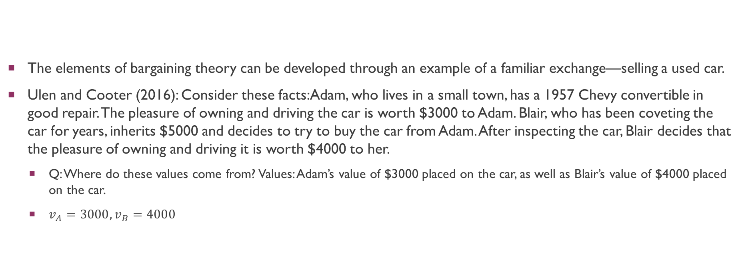
Exchange and the Coase theorem
The elements of bargaining theory can be developed through an example of a familiar exchange—selling a used car.
Ulen and Cooter (2016): Consider these facts: Adam, who lives in a small town, has a 1957 Chevy convertible in good repair. The pleasure of owning and driving the car is worth $3000 to Adam. Blair, who has been coveting the car for years, inherits $5000 and decides to try to buy the car from Adam. After inspecting the car, Blair decides that the pleasure of owning and driving it is worth $4000 to her.
Q: Where do these values come from? Values: Adam’s value of $3000 placed on the car, as well as Blair’s value of $4000 placed on the car.
$v_{A}=3000, v_{B}=4000$

Slide 6
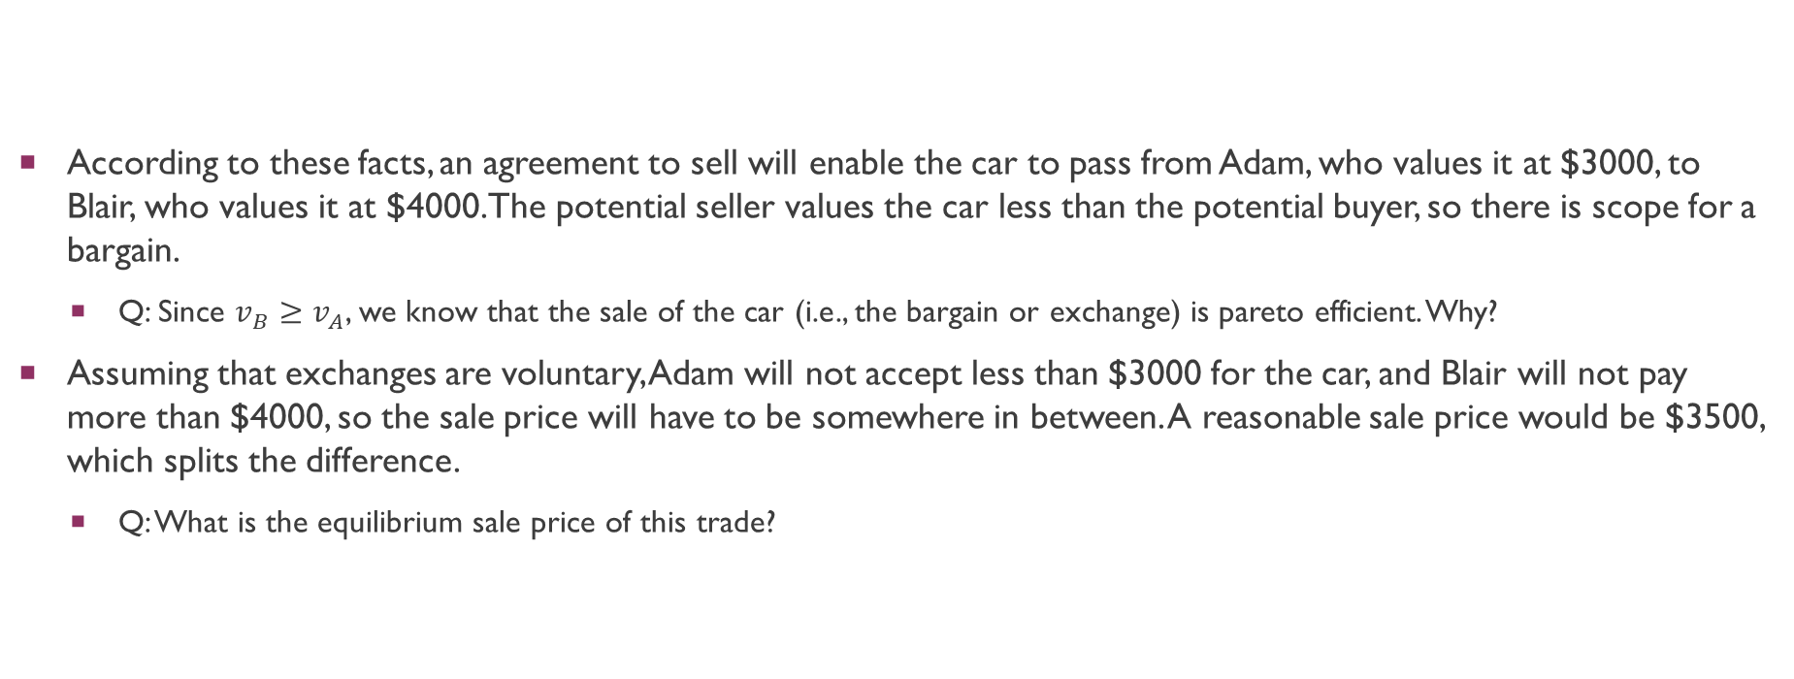
Exchange and the Coase theorem
According to these facts, an agreement to sell will enable the car to pass from Adam, who values it at $3000, to Blair, who values it at $4000. The potential seller values the car less than the potential buyer, so there is scope for a bargain.
Q: Since $v_{B}≥$ $v_{A}$, we know that the sale of the car (i.e., the bargain or exchange) is pareto efficient. Why?
Assuming that exchanges are voluntary, Adam will not accept less than $3000 for the car, and Blair will not pay more than $4000, so the sale price will have to be somewhere in between. A reasonable sale price would be $3500, which splits the difference.
Q: What is the equilibrium sale price of this trade?

Slide 7
Exchange and the Coase theorem
The logic of the situation can be clarified by restating the facts in the language of game theory. The parties to the kind of game represented by this example can both benefit from cooperating with each other. To be specific, they can move a resource (the car) from someone who values it less (Adam) to someone who values it more (Blair). Moving the resource in this case from Adam, who values it at $3000, to Blair, who values it at $4000, will create $1000 in value. The cooperative surplus is the name for the value created by moving the resource to a more valuable use.
In other words, there are gains from trade which arise from this transaction. Economists term these gains from trade the “economic surplus” which arises from trade.
Also known as the mutual benefits which arise from trade.
Of course, the share of this surplus that each party receives depends on the price at which the car is sold. If the price is set at $3500, each will enjoy an equal share of the value created by the exchange, or $500. If the price is set at $3800, the value will be divided unequally, with Adam enjoying 4/5 or $800, and Blair enjoying 1/5 or $200. Or if the price is set at $3200, Adam will enjoy $200 or 1/5 of the value created, whereas Blair will enjoy $800 or 4/5.
(Challenging): Why is there no “market price” in this specific example? What about a market for oranges? What makes this example so distinct from that of a market for oranges?

Slide 8
Exchange and the Coase theorem
Schmitz (2012): “Competitive theory studies price-taking consumers and firms—that is, people who can’t individually affect the transaction prices. The assumption that market participants take prices as given is justified only when there are many competing participants. We have also examined monopoly, precisely because a monopoly, by definition, doesn’t have to worry about competitors. Strategic behavior involves the examination of the intermediate case, where there are few enough participants that they take each other into account—and their actions individually matter—so that the behavior of any one participant influences choices of the other participants. That is, participants are strategic in their choices of action, recognizing that their choices will affect choices made by others. The right tool for the job of examining strategic behavior in economic circumstances is game theory, the study of how people play games.”
What has this got to do with our example above?

Slide 9
Exchange and the Coase theorem
Ulen and Cooter (2016): In any voluntary agreement, each player must receive at least the threat value or there is no advantage to cooperating. A reasonable solution to the bargaining problem is for each player to receive the threat value plus an equal share of the cooperative surplus: specifically, $3500 for Adam and $5500 for Blair. To accomplish the division, Blair should pay Adam $3500 for the car. This leaves Adam with $3500 in cash and no car, and leaves Blair with a car worth $4000 to her and $1500 in cash.
The parties typically bargain with each other over the price. In the course of negotiating, the parties may assert facts (“The motor is mechanically perfect. . . .”), appeal to norms (“$3700 is an unfair price. . . .”), threaten (“I won’t take less than $3500. . . .”), and so forth. These are the tools used in the art of bargaining… [However, even] when negotiation is possible, however, there is no guarantee that it will succeed. If the negotiations break down and the parties fail to cooperate, their attempt to shift resources to a more valuable use will fail, and they will not create value. Thus, the obstacle to creating value in a bargaining game is that the parties must agree on how to divide it. Value will be divided between them at a rate determined by the price at which the car is sold. Agreement about the car’s price marks successful negotiations, whereas disagreement marks a failure in the bargaining process.
Is the state of affairs “efficient” if Blair and Adam fail to agree on a price to trade the car? Why?

Slide 10
Exchange and the Coase theorem
Earlier, we simply assumed that Adam values the car at $4000, and that Blair values the car at $3000.
It turns out that this heterogeneity (i.e., differences) in values is endemic across modern commerce.
Why? Differences in preferences (and thus, valuations) arise from the (1) returns to specialization as well as from (2) economies of scale.
Collectively, economists refer to these potential gains from trade as gains which arise varying comparative advantages.
These are abstract concerns, but they happen to be crucial in corporate law. We will provide concrete examples in subsequent slide decks.
For now, we will take the existence of these gains as given so as to motive the Coase Theorem…

Slide 11
Exchange and the Coase theorem
Ulen and Cooter (2016): Let us [now] imagine a simplified world in which there are people, land, farm tools, and weapons but no courts and no police. In this imaginary world, government does not vindicate and protect the rights to property asserted by the people who live on the land. Individuals, families, or alliances of families enforce property rights to the extent that they defend their land holdings. People must decide how many resources to devote to defending their property claims… Rational people allocate their limited resources so that, the marginal cost of defending land is just equal to the marginal benefit…

Slide 12
Exchange and the Coase theorem
Ulen and Cooter (2016): The same bargaining model used to explain the sale of a secondhand car can be applied to this thought experiment, in which a primitive society develops a system of property rights. First, a description is given of what people would do in the absence of civil government, when military strength alone established ownership claims. That situation—called the state of nature—corresponds to the threat values of the noncooperative solution, which prevails if the parties cannot agree. Second, a description is given of the advantages of creating a government to recognize and enforce property rights. Civil society, in which such a government exists, corresponds to the game’s cooperative solution, which prevails if the parties can agree. The social surplus, defined as the difference between the total amount spent defending land in the state of nature and the total cost of operating a property-rights system in civil society, corresponds to the cooperative surplus in the game. Third, an agreement describes the methods for distributing the advantages from cooperation. In the car example, this agreement arises from the price that the buyer offers and the seller accepts. In the thought experiment, this agreement arises from the social contract that includes the fundamental laws of property.
Our thought experiment answers the question, “Why are ownership rights established?”… Societies create property as a legal right to encourage production, discourage theft, and reduce the costs of protecting goods.
Before we turn to the Coase theorem, do you find Ulen and Cooter (2016)’s thought experiment persuasive? Why or why not?

Slide 13
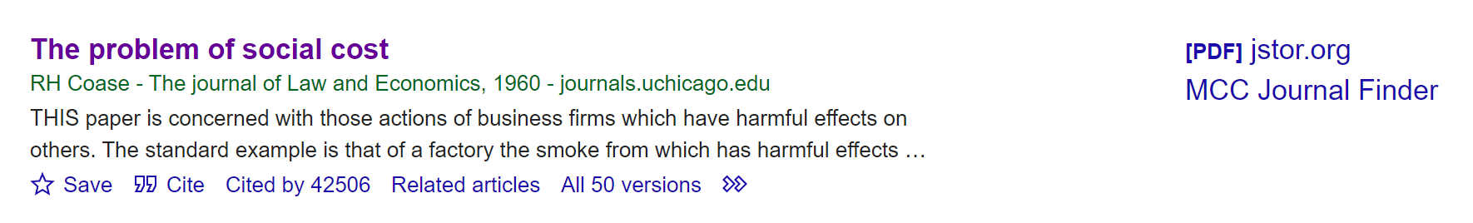
Exchange and the Coase theorem
The Coase Theorem is an “invariance theorem”.
The Coase Theorem is known for its counter-intuitive implications, that (1) (pareto) efficient outcomes arise no matter how the law allocates property rights, (2) as long as specific conditions are met.
It is the most cited publication in all of legal academia. Can you find a law-related article which is more widely cited?

Slide 14
Exchange and the Coase theorem
The theorem is best motivated by an example (by Ulen and Cooter (2016)). A cattle rancher lives beside a farmer. The farmer grows corn on some of his land and leaves some of it uncultivated. The rancher runs cattle over all of her land. The boundary between the ranch and the farm is clear, but there is no fence. Thus, from time to time the cattle wander onto the farmer’s property and damage the corn.
The damage could be reduced by building a fence, continually supervising the cattle, keeping fewer cattle, or growing less corn – each of which is costly.
Notice how none of these costly actions invoke the law thus far. Is there an analogy in corporate law?
The rancher and the farmer could:
Bargain with each other to decide who should bear the cost of the damage.
Alternatively, the law could intervene and assign liability for the damages.
Q: Is there a key difference between the two options available for a “policymaker”?

Slide 15
Exchange and the Coase theorem
If the law intervenes, there are two specific rules the law could adopt:
The farmer is responsible for keeping the cattle off his property, and he must pay for the damages when they get in (a regime we could call “ranchers’ rights” or “open range”, or “no liability”), or
The rancher is responsible for keeping the cattle on her property, and she must pay for the damage when they get out (“farmers’ rights” or “closed range”, or “rancher liability”).
Under the first rule, the farmer would have no legal recourse against the damage done by his neighbor’s cattle. To reduce the damage, the farmer would have to grow less corn or fence his cornfields. Under the second rule, the rancher must build a fence to keep the cattle on her property. If the cattle escape, the law could ascertain the facts, determine the monetary value of the damage, and make the rancher pay the farmer.

Slide 16
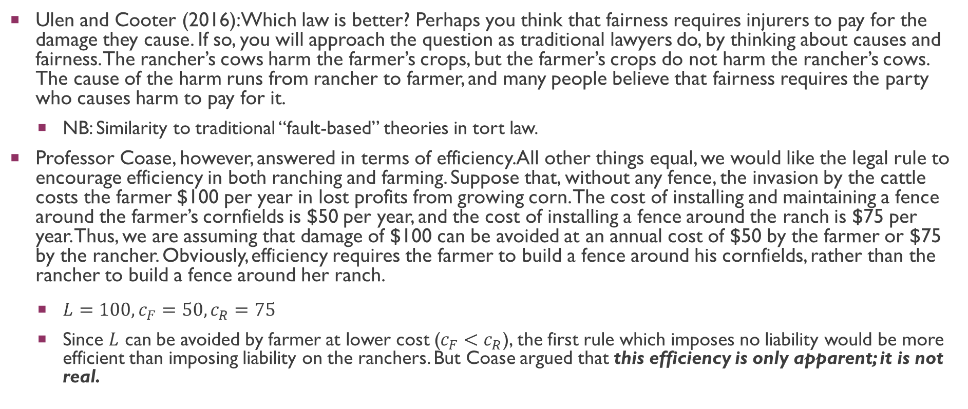
Exchange and the Coase theorem
Ulen and Cooter (2016): Which law is better? Perhaps you think that fairness requires injurers to pay for the damage they cause. If so, you will approach the question as traditional lawyers do, by thinking about causes and fairness. The rancher’s cows harm the farmer’s crops, but the farmer’s crops do not harm the rancher’s cows. The cause of the harm runs from rancher to farmer, and many people believe that fairness requires the party who causes harm to pay for it.
NB: Similarity to traditional “fault-based” theories in tort law.
Professor Coase, however, answered in terms of efficiency. All other things equal, we would like the legal rule to encourage efficiency in both ranching and farming. Suppose that, without any fence, the invasion by the cattle costs the farmer $100 per year in lost profits from growing corn. The cost of installing and maintaining a fence around the farmer’s cornfields is $50 per year, and the cost of installing a fence around the ranch is $75 per year. Thus, we are assuming that damage of $100 can be avoided at an annual cost of $50 by the farmer or $75 by the rancher. Obviously, efficiency requires the farmer to build a fence around his cornfields, rather than the rancher to build a fence around her ranch.
$L=100, c_{F}=50,c_{R}=75$
Since $L$ can be avoided by farmer at lower cost ($c_{F}<c_{R}$), the first rule which imposes no liability would be more efficient than imposing liability on the ranchers. But Coase argued that this efficiency is only apparent; it is not real.

Slide 17
Exchange and the Coase theorem
Ulen and Cooter (2016): Imagine how the rancher and the farmer could have resolved their problem by cooperative bargaining… then compare that outcome with the apparent outcomes under the different legal rules. Suppose that the farmer and the rancher had married and combined their business interests. They would then maximize the combined profits from farming and ranching, and these joint profits will be highest when they build a fence around the cornfields, not around the ranch. Consequently, the married couple will build a fence around the cornfields, regardless of whether the law is the first rule or the second rule.
In other words, they will cooperate to maximize their joint profits, regardless of the rule of law.
The farmer and the rancher do not need to get married in order to cooperate. Rational businesspeople can often bargain together and agree on terms of cooperation. By bargaining to an agreement, rather than following the law noncooperatively, the rancher and the farmer can save $25. That is, if the parties can bargain successfully with each other, the efficient outcome will be achieved, regardless of the rule of law.
This possibility of “bargaining around the law” is known as “Coasean bargaining” by economists. How would this work given the aforementioned example?

Slide 18
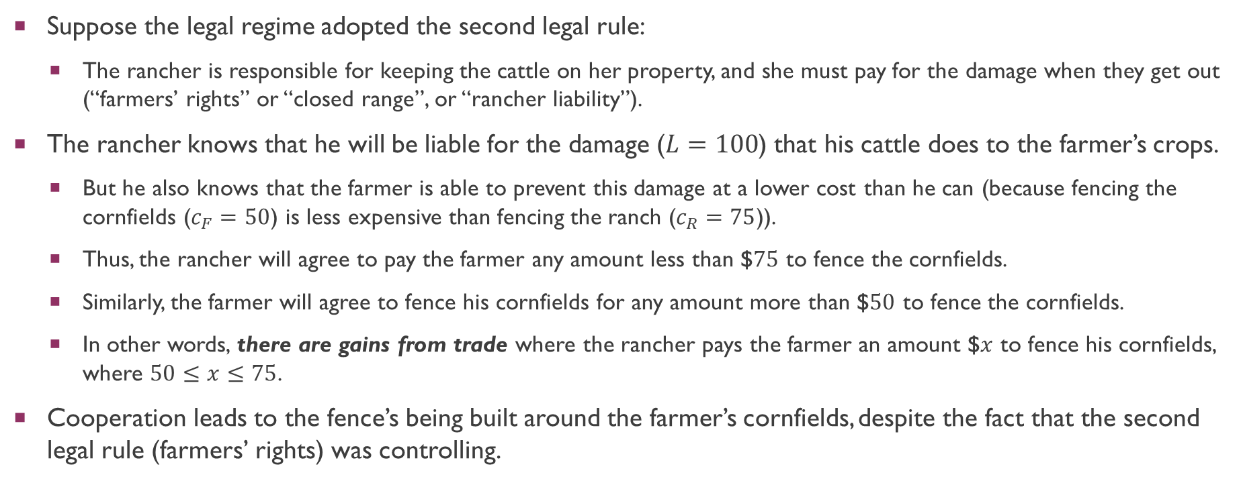
Exchange and the Coase theorem
Suppose the legal regime adopted the second legal rule:
The rancher is responsible for keeping the cattle on her property, and she must pay for the damage when they get out (“farmers’ rights” or “closed range”, or “rancher liability”).
The rancher knows that he will be liable for the damage ($L=100$) that his cattle does to the farmer’s crops.
But he also knows that the farmer is able to prevent this damage at a lower cost than he can (because fencing the cornfields ($c_{F}=50$) is less expensive than fencing the ranch ($c_{R}=75$)).
Thus, the rancher will agree to pay the farmer any amount less than $$75$ to fence the cornfields.
Similarly, the farmer will agree to fence his cornfields for any amount more than $$50$ to fence the cornfields.
In other words, there are gains from trade where the rancher pays the farmer an amount $$x$ to fence his cornfields, where $50≤x≤75$.
Cooperation leads to the fence’s being built around the farmer’s cornfields, despite the fact that the second legal rule (farmers’ rights) was controlling.

Slide 19
Exchange and the Coase theorem
All of the aforementioned analysis presupposes successful bargaining so as to realize gains from trade.
In reality, while bargaining can occasionally be successful, it often falls short. Why?
Ulen and Cooter (2016): Bargaining occurs through communication between the parties. Communication has various costs, such as renting a conference room, hiring a stenographer, and spending time in discussion. Coase used the term “transaction costs” to refer to the costs of communicating, as well as to a variety of other costs that we will discuss later. In fact, he used “transaction costs” to encompass all of the impediments to bargaining. Given this definition, bargaining necessarily succeeds when transaction costs are zero.
In other words, one version of the Coase Theorem may be stated as:
When transaction costs are zero, an efficient use of resources results from private bargaining, regardless of the legal assignment of property rights.
But the corollary of this proposition is also immediate:
When transaction costs are high enough to prevent bargaining, the efficient use of resources will depend on how property rights are assigned.
Why is this important for Corporate Law? More generally, what are the implications of the Coase theorem for law?

Slide 20
Exchange and the Coase theorem
Before we turn to the nature of these “transaction costs” within the typical corporation, let us try to motivate them more generally in the context of commerce.
Ulen and Cooter (2016): Transaction costs are the costs of exchange. An exchange has three steps. First, an exchange partner has to be located. This involves finding someone who wants to buy what you are selling or sell what you are buying. Second, a bargain must be struck between the exchange partners. A bargain is reached by successful negotiation, which may include the drafting of an agreement. Third, after a bargain has been reached, it must be enforced. Enforcement involves monitoring performance of the parties and punishing violations of the agreement. We may call the three forms of transaction costs corresponding to these three steps of an exchange: (1) search costs, (2) bargaining costs, and (3) enforcement costs.
What are enforcement costs? Hint: Consider your intended profession!

Slide 21
Exchange and the Coase theorem
Ulen and Cooter (2016): [Concerning] bargaining costs, note that our examples of bargaining assumed that both parties know each other’s threat values and the cooperative solution. Game theorists say that information is “public” in negotiations when each party knows these values. (Game theorists refer to these negotiations as “common knowledge” situations.) Conversely, information is “private” when one party knows some of these values and the other does not. If the parties know the threat values and the cooperative solution, they can compute reasonable terms for cooperation. In general, public information facilitates agreement by enabling the parties to compute reasonable terms for cooperation. Consequently, negotiations tend to be simple and easy when information about the threat values and the cooperative solution is public. To illustrate, negotiations for the sale of a watermelon are simple because there is not much to know about it.

Slide 22
Exchange and the Coase theorem
Ulen and Cooter (2016) (cont): Negotiations tend to be complicated and difficult when information about threat values and the cooperative solution is private. Private information impedes bargaining because much of it must be converted into public information before computing reasonable terms for cooperation. In general, bargaining is costly when it requires converting a lot of private information into public information. To illustrate, negotiations for the sale of a house involve many issues of finance, timing, quality, and price. The seller of a house knows a lot more about its hidden defects than the buyer knows, and the buyer knows a lot more about his or her ability to obtain financing than the seller knows. Each attempts to extract these facts from the other over the course of negotiations. To a degree, the parties may want to divulge some information. But they may be reluctant to divulge all. Each party’s share of the cooperative surplus depends, in part, on keeping some information private. But concluding the bargain requires making some information public. Balancing these conflicting pulls is difficult and potentially costly.

Slide 23
Exchange and the Coase theorem
What about Contract Law?
For the purposes of this course, the exact same intuition applies – like it did to the analysis of property rights/rules.
Recall an earlier example from Ulen and Cooter (2016): “Moving the resource in this case from Adam, who values it at $3000, to Blair, who values it at $4000, will create $1000 in value. The cooperative surplus is the name for the value created by moving the resource to a more valuable use.” In other words, there are gains from trade which arise from this transaction.
Ulen and Cooter (2016): “The enforceability of a contract usually makes the parties better off, as measured by their own desires, without making anyone worse off. (i.e., it is pareto efficient)… Economic efficiency usually requires enforcing a promise if the promisor and promisee both wanted enforceability when it was made.”
How does Contract Law facilitate gains from trade?

Slide 24
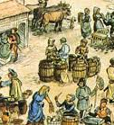
Exchange and the Coase theorem
Ulen and Cooter (2016): Many exchanges occur instantly and simultaneously, as when a shopper pays cash for goods in the grocery store. In a simultaneous, instantaneous exchange, there is little reason to promise anything.
Economists term these types of exchanges as spot contracts.
Spot contracts serve as a useful benchmark, as many of these transactions can occur without the need for legal frameworks or institutions.
Example: Are formal contracts important when you buy a drink from a street vendor? Why or why not?
Historically, we know that humans have been trading for millennia, long before the establishment of legal institutions (see Greif (1989) on Maghribi Traders).

Slide 25
Exchange and the Coase theorem
Ulen and Cooter (2016) (cont): The making of promises, however, typically concerns deferred exchanges—that is, transactions that involve the passage of time for their completion. For example, one party pays now and the other promises to deliver goods later (“payment for a promise”); one party delivers goods now and the other promises to pay later (“goods for a promise”); or one party promises to deliver goods later, and the other promises to pay when the goods are delivered (“promise for a promise”).
The passage of time between the exchange of promises and their performance creates uncertainties and risks. Thus, the seller asks the buyer to pay now for future delivery of goods. The cautious buyer wants a legal obligation of the seller to deliver the goods, not just a moral obligation. The buyer may be willing to pay now for an enforceable promise, but not for an unenforceable promise. Recognizing these facts, both parties want the seller’s promise to be enforceable at the time it is made. The seller wants enforceability in order to induce the buyer to make the purchase, and the buyer wants enforceability to provide an incentive for seller’s performance and a remedy for seller’s breach.
By enforcing such promises, the court gives both parties what they want and facilitates cooperation between them.

Slide 26

Exchange and the Coase theorem
Example: Consider a potential project to construct a large hotel for 20 Mil SGD.
Does this transaction involve a “simultaneous exchange”?
What are the relevant terms involved which have a temporal dimension to them?
What would happen if there were no legal regime of contract law to enforce contracts related to such a project?

Slide 27
Exchange and the Coase theorem
Ulen and Cooter (2016) (cont): To develop these insights, we describe a situation called the “agency game” that often arises in business. In this game, the first player decides whether to put a valuable asset under the control of the second player. The first player might be an investor in a corporation, a consumer advancing funds to purchase goods, a depositor at a bank, the buyer of an insurance policy, or a shipper of goods, to list some possibilities.
If the first player puts the asset under the second player’s control, the second player decides whether to cooperate or appropriate.
Cooperation is productive, whereas appropriation is redistributive.
Productivity could take the form of the profit from investment, the surplus from trade, or the interest from a loan.
The parties divide the product of cooperation between them, so both of them benefit.
In contrast, appropriation redistributes from the first player to the second player.
Intuition re appropriation as termed by Ulen and Cooter (2016): “Running away” with the asset/ “Stealing” the asset.
Q: Why have we not discussed “redistribution” thus far? Hint: It relates to what we discussed earlier concerning efficiency…

Slide 28
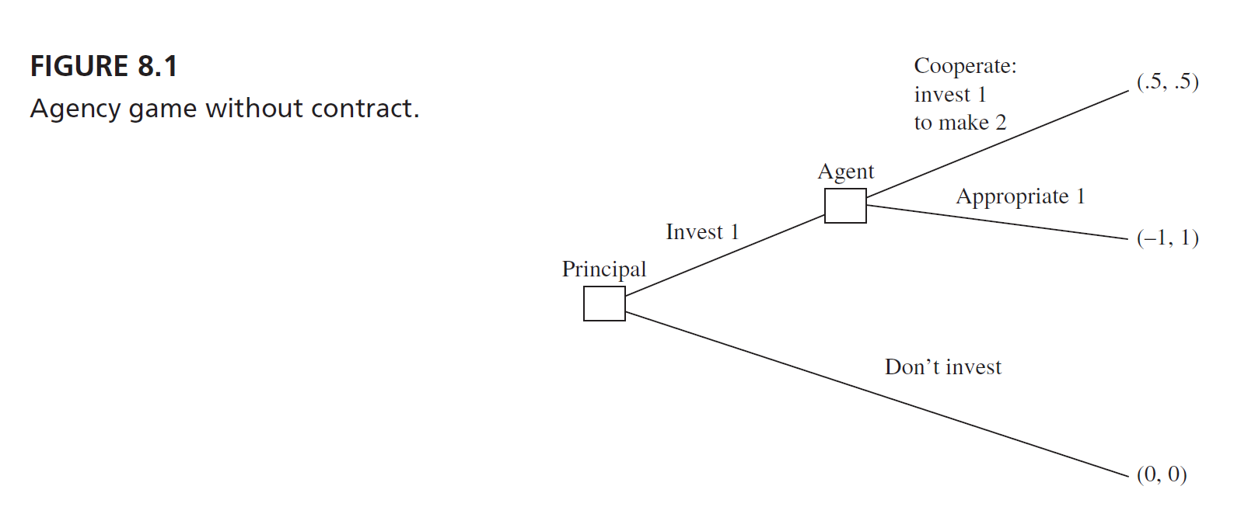
Exchange and the Coase theorem
What is the best payoff for both parties involved?
Notwithstanding the efficient course of action, what is the agent likely to do in this scenario?
Let’s use backward induction to determine the equilibrium!

Slide 29
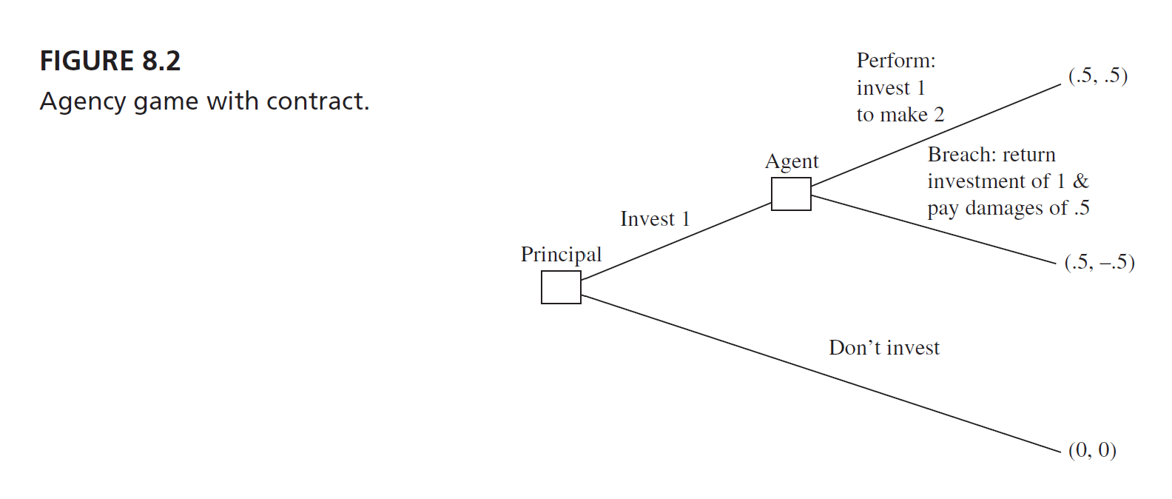
Exchange and the Coase theorem
Let’s change the legal regime to one where contract law exists.
What is the best payoff for both parties involved?
Is the efficient outcome attained in this (simple) sequential game? Why?

Slide 30
Exchange and the Coase theorem
Ulen and Cooter (2016) (cont): Modern business activity provides countless examples of the agency game. Thus, an innovator in Silicon Valley asks a venture capitalist to invest $1 million in a start-up company to develop a new computer chip. By developing the chip, the innovator can turn $1 million into $2 million. The innovator promises to develop the chip and share the profits of $1 million equally with the investor. Instead of developing the chip, however, the innovator might try to appropriate the investor’s $1 million. An enforceable promise to develop the chip will prevent the innovator from appropriating the money; so, the investor will trust the innovator and invest the money.
[Turning back to the earlier example]… Investing and cooperating are productive, whereas “don’t invest” changes nothing and “appropriate” merely redistributes money from the first player to the second player. Given these facts, we could restate the preceding conclusion: The first purpose of contract law is to enable people to convert games with inefficient solutions into games with efficient solutions.
How does this relate to the “bargaining problem” concerning the sale of a car between Adam and Blair?

Slide 31
Exchange and the Coase theorem
Ulen and Cooter (2016): The language of game theory clarifies how enforceable contracts promote cooperation. In game theory, a commitment forecloses an opportunity… Making a contract commits the second player in Figure 8.2 to cooperate. Commitment is achieved by foreclosing the opportunity to appropriate. The opportunity to appropriate is foreclosed by the high cost of liability for breach. A commitment is credible when the other party observes the foreclosing of an opportunity.
The chef at the resort asks whether you would prefer a menu of chicken or beef for dinner, or a menu of chicken or beef or fish. Perhaps you think to yourself, “A wider choice cannot make me worse off, and it might make me better off.” This is true for many restaurant choices, but it is false for coordinating with others in situations like the agency game. You may need to commit not to make certain choices in order to induce the other party to cooperate with you.
[Returning to the aforementioned example]… The agency game shows why both parties usually want enforceability: So the agent can credibly commit to performing and the principal has sufficient trust to put an asset under the agent’s control.

Slide 32
Exchange and the Coase theorem
To summarize, in this lecture, we have discovered:
The fundamental assumptions which drive economic analysis
Why exchange/trade is normatively desirable
How the legal framework may or may not support exchange
How the existence of property and contract law may facilitate mutually beneficial exchange
We now possess the tools to examine the underlying principles of company law. We will turn to this in the next deck of slides…

Slide 33
Q&A
See you guys on Tue.

